Slide 1
Houston Pothole Analysis
A LOOK INTO THE PREDICTABILITY OF POTHOLE CREATION BASED ON WEATHER CONDITIONS

Slide 2
Overview
Purpose
Data Wrangling
EDA
Preprocessing, Modelling, Results (for practice)

Slide 3
Purpose
The purpose of this deep dive is to come up with a predictive model for determining pothole creation location in Houston, Texas while utilizing the existing pothole data and weather forecast data. If potholes could be predicted it could allow for better planning for commuters and better planning for the city to distribute resources more effectively. The City of Houston has a next day policy for pothole repairs, so the more notice, the better.

Slide 4
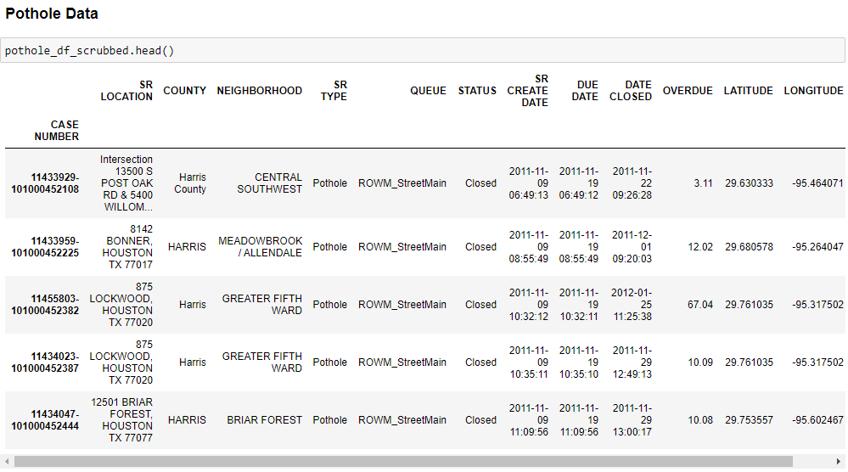
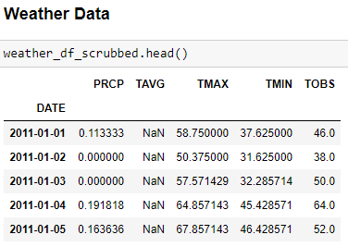
Data Wrangling
Weather data → NOAA
Pothole data → City of Houston

Slide 5
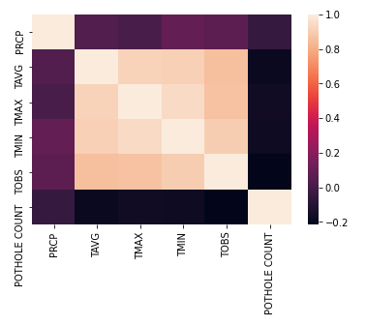
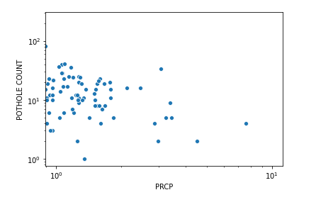
EDA
No Correlation between Precipitation/Temperature and Reported Pothole Count, even when done on each of the 96 regions of Houston, rather than all of Houston

Slide 6
Training, Modelling
Training
Models
Model | Mean Absolute Error | Standard Deviation
Linear Regression | 9.43 | 0.27
Random Forest | 9.96 | 0.33
Logistic Regression | 10.15 | 0.43
StandardScalar()
Split into training/test(30%)
Linear Regression had least MAE and Std so this model would have been chosen……
BUT…..data was not statistically correlated so will need to pursue another analysis, possibly on a more regional granularity

